Slide 1
Problems with Consent Theory
Introduction to Political Theory
Semester 2 Week 3 Lecture
Dr. Billy Christmas

Slide 2
Locke: we tacitly consent to the state through: 1. Continued residence within its borders 2. Benefitting from the legal system it upholds

Slide 3

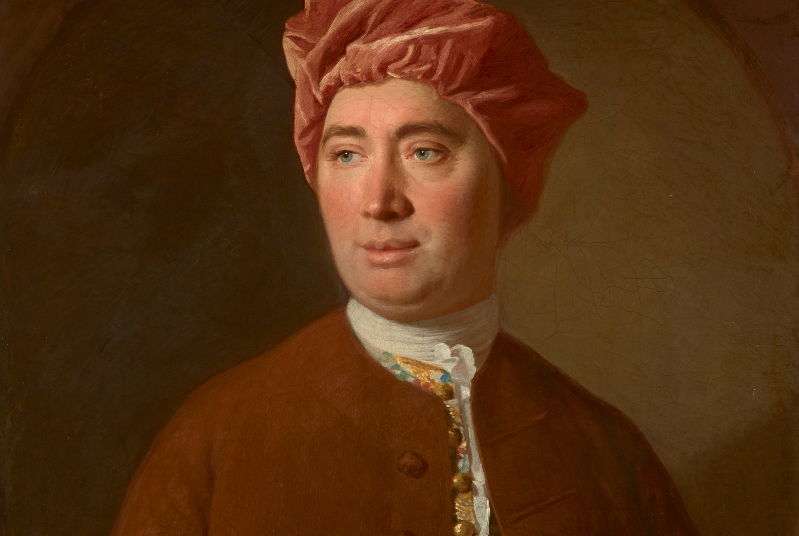
Hume’s Critique of Locke

Slide 4
Domestic Abuse Analogy

Slide 5
A potential Lockean reply: Ongoing residence only authorises good or just government, not unjust or tyrannical states

Slide 6
Pitkin’s Critique If you leave a state then it is not authorise with regard to you If you stay, it is automatically authorised so long as it is just → Where has consent gone?

Slide 7
Simmons Partial Defence of Consent Theory Consent is necessary but not sufficient for obligation: Consenting to unjust laws does not authorise them Reasonably just laws are only authorised if they are consented to → Ongoing residence without territory does not constitute tacit consent

Slide 8
Tacit Consent vs. Implied Consent

Slide 9
Tacit Consent Consent expressed through inaction Given through not dissenting at appropriate occasion

Slide 10
Implied Consent Consent that is assumed on the basis that it may correlate with other actions Does not mean consent was in fact given

Slide 11
The Boardroom Example

Slide 12
Five Conditions of Tacit Consent

Slide 13
1. Definite and known moment in which giving dissent is appropriate 2. Definite and known period of reasonable duration 3. Definite and known point where that period comes to an end 4. Definite, known, and easy means by which dissent is given 5. Consequences of dissent cannot be extremely detrimental

Slide 14
Thank You!

